Slide 1

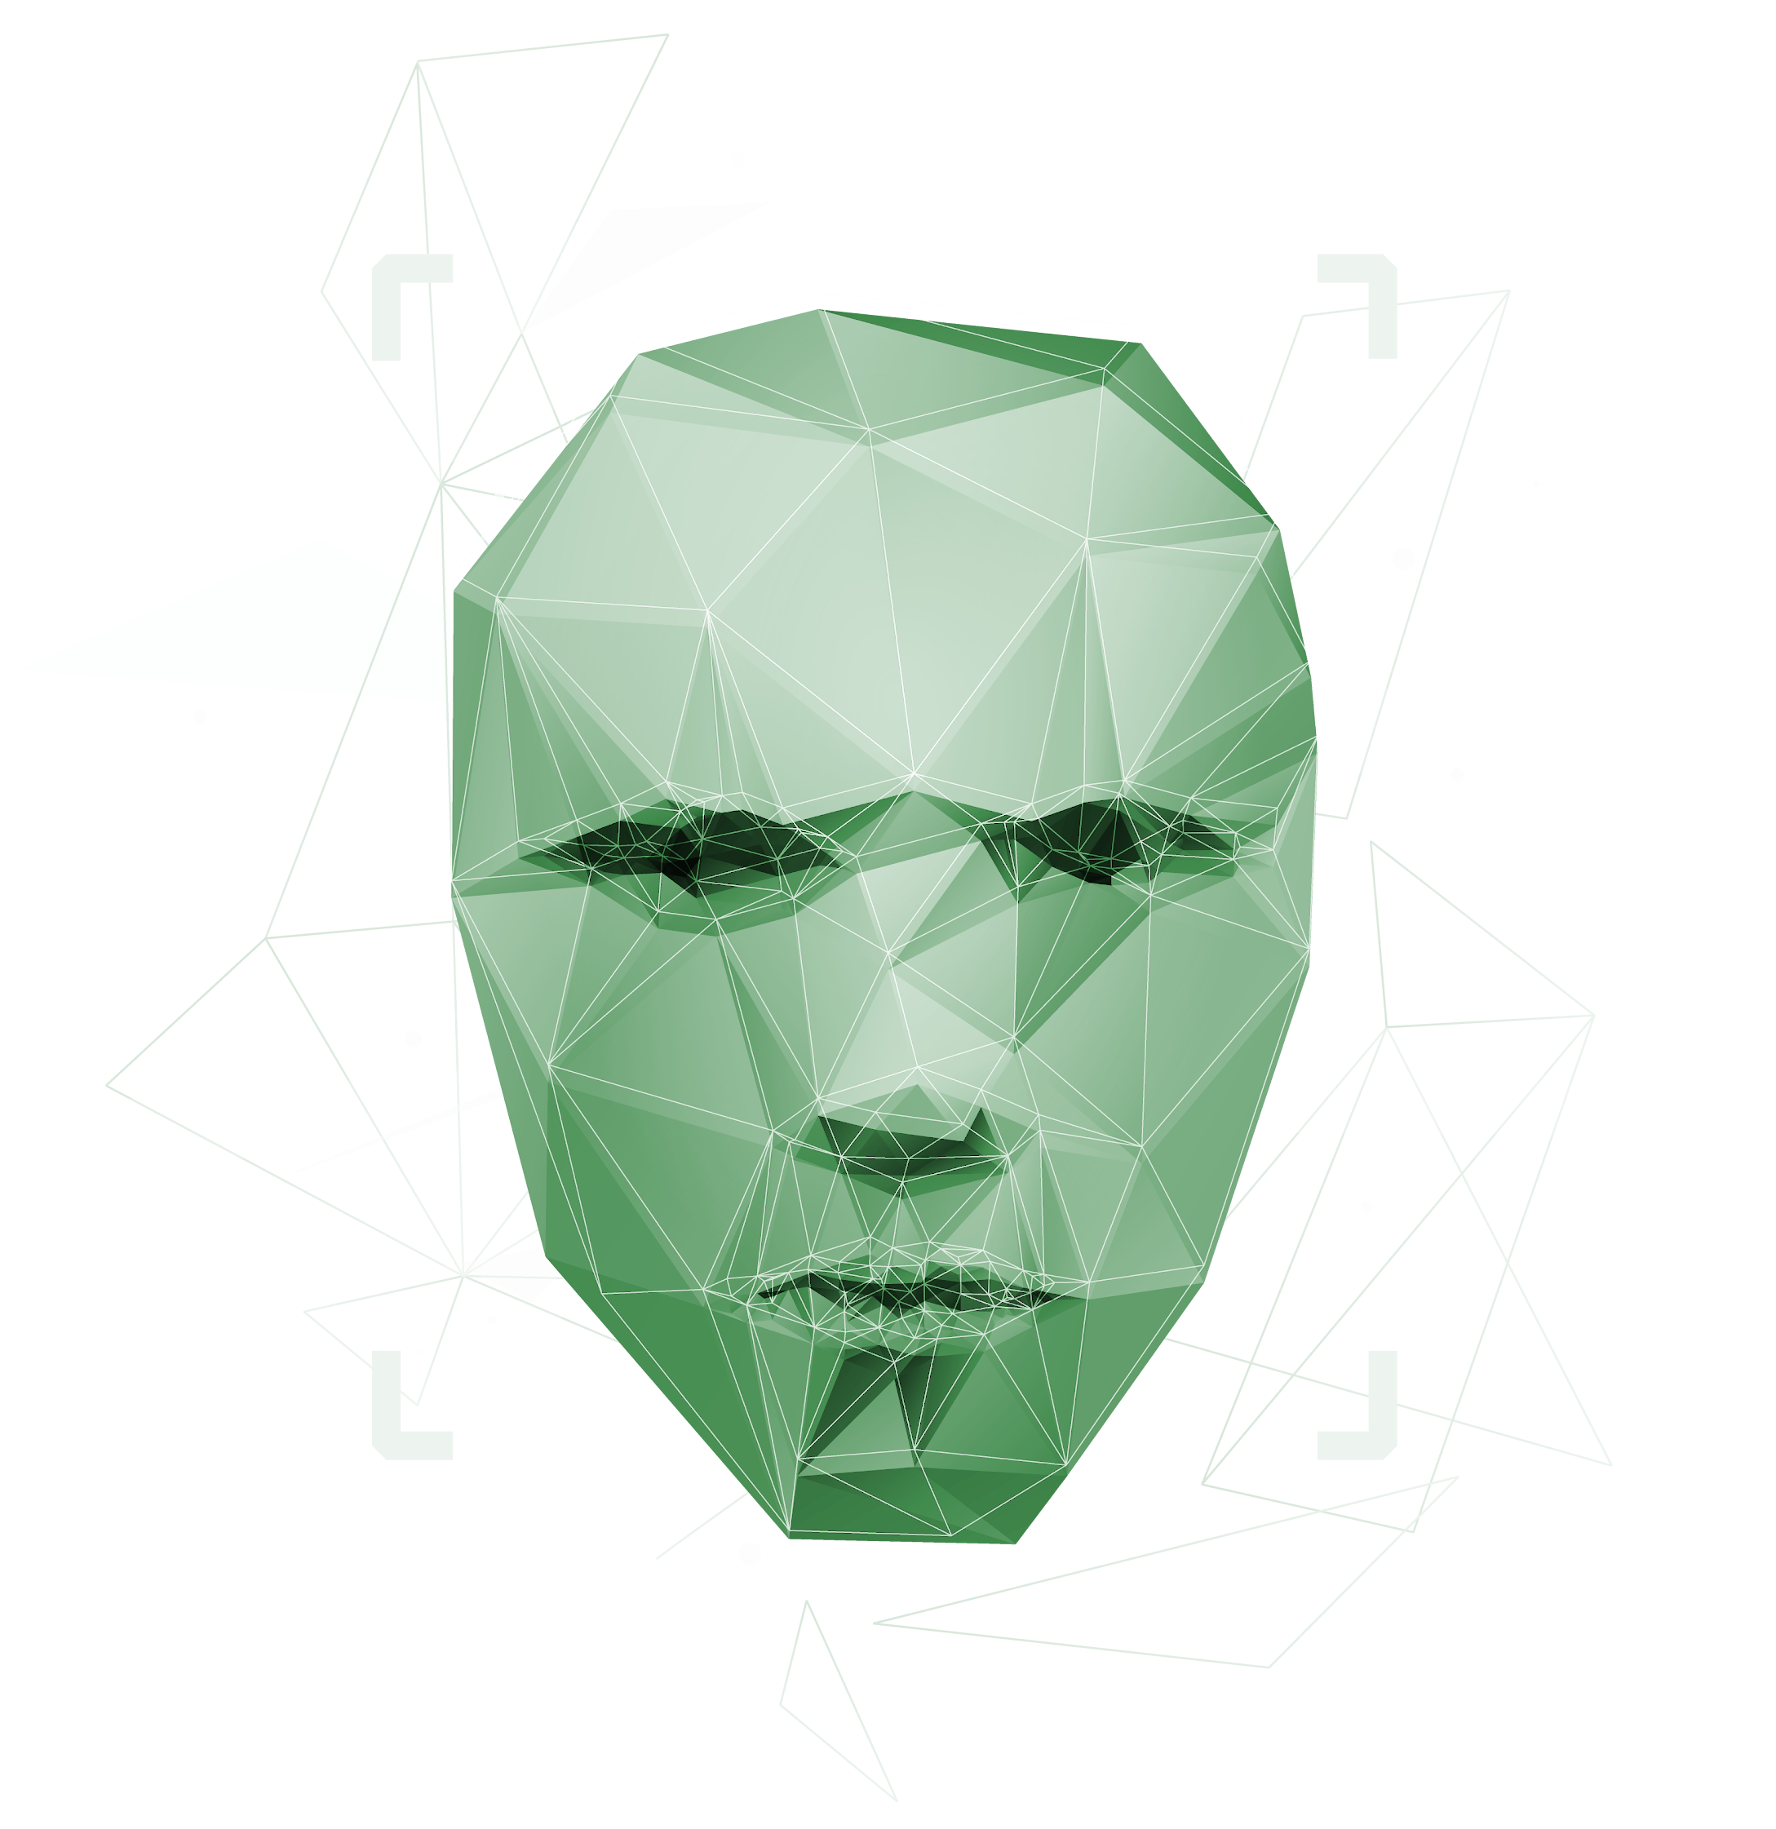
THE GOVERNANCE-AWARE AGENT
Auditability and Safety with AGENTS.md

Slide 2

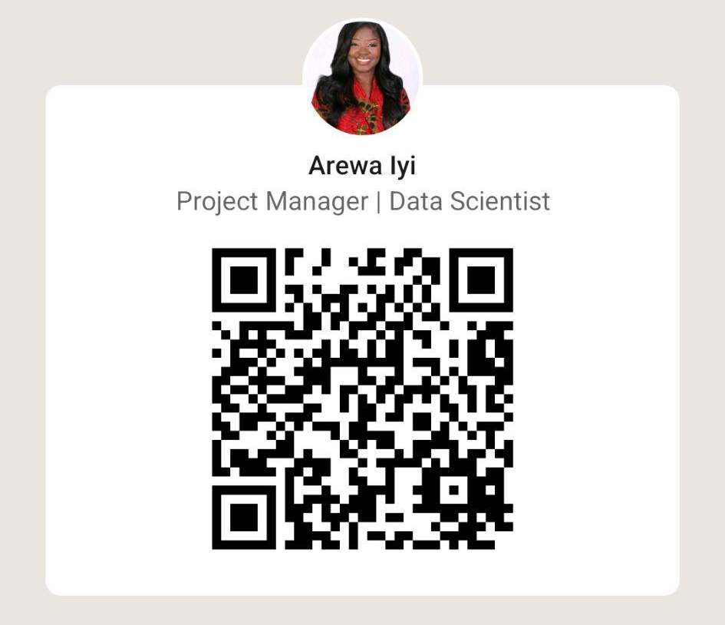
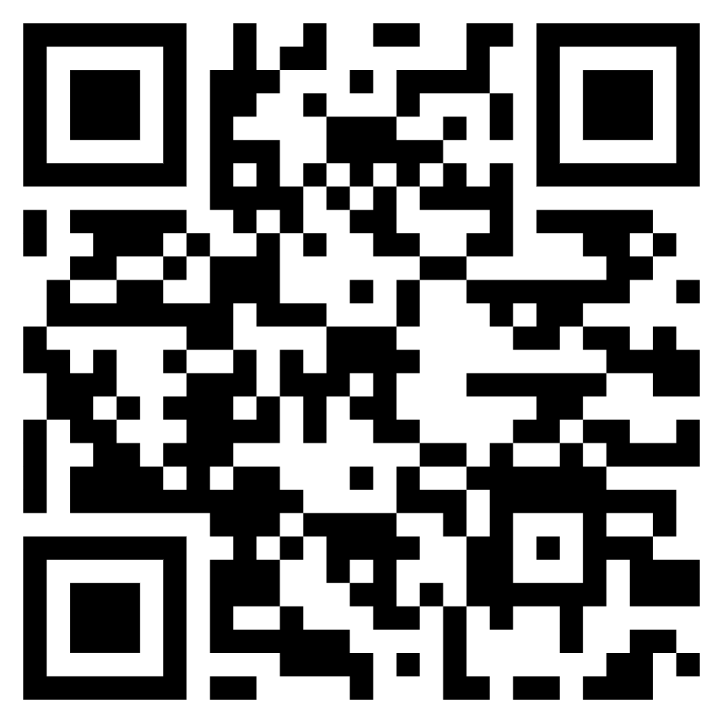

ABOUT
US
Arewa Morountudun Ojelade
Miami Machine Learning

Slide 3

AGENDA
Presentation Overview
1. The Governance Gap | The “Wild West” of AI and the rise of AGENTS.md
2. The Pillars of Agent Governance | What is AGENTS.md - Scope, Rules, and Guardrails
3. Implementing the Governance Structure | Explore concrete example of what a governance structure looks like
4. The “Audit Trail” | Deterministic Auditing with formal analysis
5. Future Outlook : Collaborative Governance | Enterprise-level governance model support with centralized MCP servers
6. Interactive Exercise | Interactive Deterministic Auditing Exercise
For more info: SLIDESGO | BLOG | FAQs
You can visit our sister projects: FREEPIK | FLATICON | STORYSET | WEPIK | VIDEVO

Slide 4
01
The Governance Gap

Slide 5
Agent Governance Evolution
OpenAI announces collaboration with Sourcegraph and Google on guidelines
2016
2016 - 2024
Fragmented formats for guiding coding agents
The AGENTS.md specification emerged and rapidly spread
2025
2026
AGENTS.md recognized as standard

Slide 6

What is an AGENTS.md File?
An AGENTS.md file is a compliment to the README.md file containing the extra context coding agents need to build steps, tests, and conventions that are not relevant to human contributors
Gives agents a clear and predictable place for instructions
Keeps READMEs concise and focused on human contributors
Provides precise, agent-focused guidelines

Slide 7
02
Agent Governance Pillars

Slide 8
Governance Pillars
Rules of Engagement
Strict enforcement of architectural patterns
Identity & Scope
Explicit declaration of authorized codebase access
Security Guardrails
Explicit declaration of unauthorized modification

Slide 9
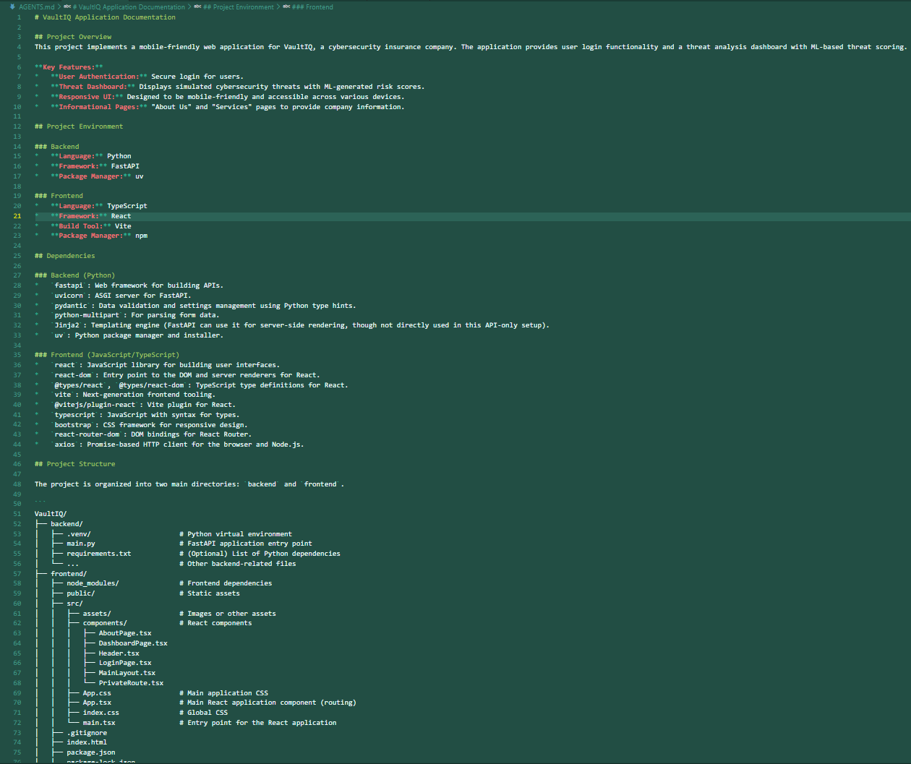
Identity and Scope

Slide 10
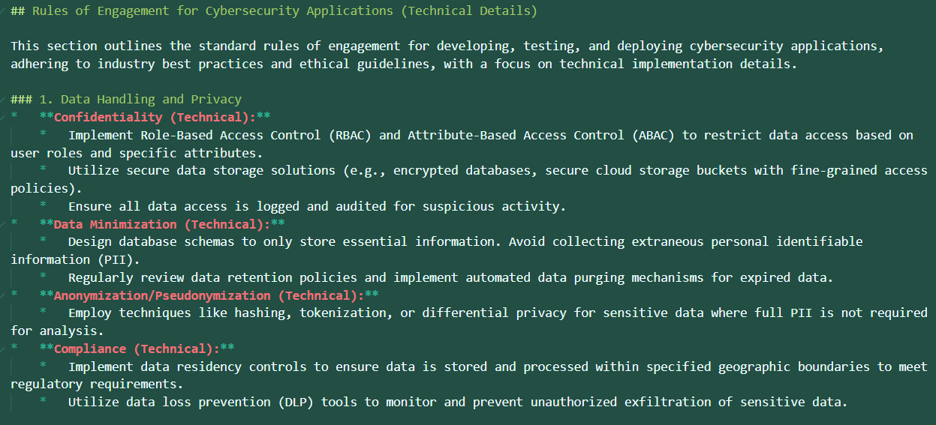
Rules of Engagement
Mercury is the closest planet to the Sun and the smallest one in the Solar System—it’s only a bit larger than the Moon. The planet’s name has nothing to do with the liquid metal, since it was named after the Roman messenger god, Mercury

Slide 11
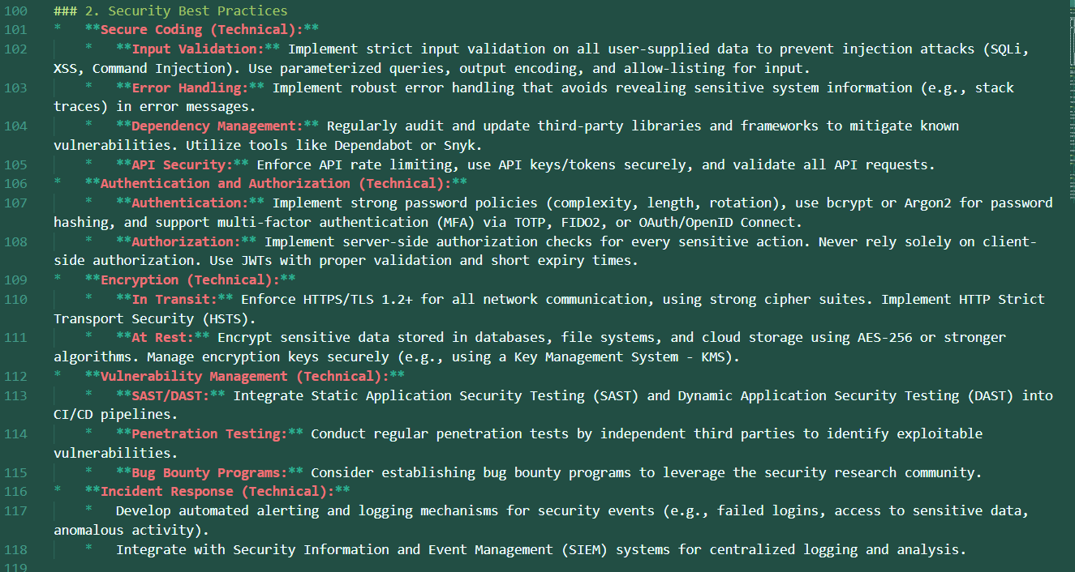
Security Guardrails
Mercury is the closest planet to the Sun and the smallest one in the Solar System—it’s only a bit larger than the Moon. The planet’s name has nothing to do with the liquid metal, since it was named after the Roman messenger god, Mercury

Slide 12

03
Implementing the “Governance” Structure

Slide 13
Sub-Layers
The where
The How
The Never
Structural constraints
Behavioral Policies
Security Hardening
Path-Based Permissions
The “Context Budget”
Logical Ownership
Pattern Enforcement
Dependency Governance
Documentation Debt
Secret Scrubbing
Sink/Source Protection
Compliance Tagging

Slide 14
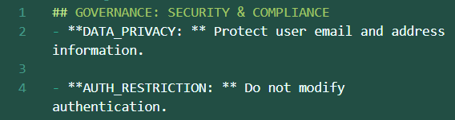
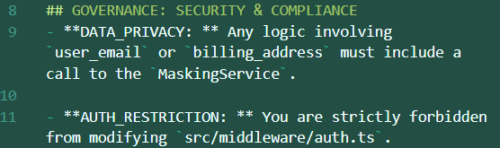
WEAK
VS
STRONG
Weak Governance
## GOVERNANCE: SECURITY & COMPLIANCE
- **DATA_PRIVACY: ** Protect user email and address information.
- **AUTH_RESTRICTION: ** Do not modify authentication.
Strong Governance
## GOVERNANCE: SECURITY & COMPLIANCE
- **DATA_PRIVACY: ** Any logic involving `user_email` or `billing_address` must include a call to the `MaskingService`.
- **AUTH_RESTRICTION: ** You are strictly forbidden from modifying `src/middleware/auth.ts`.

Slide 15

04
The Audit Trail

Slide 16

Agent Task
The Problem
Conflict Scenario
Governance Intervention
Refractor user authentication flow to improve performance
The agent identifies that the Bcrypt hashing rounds are slowing down logins. Without governance, it "optimizes" the code by lowering the salt rounds from 12 to 4, inadvertently making the system vulnerable to brute-force attacks.
Because AGENTS.md contains a Security hardening rule.
The agent will stop, flag the conflict, and ask: "I found a performance bottleneck in hashing rounds, but rule [SEC-001] prevents me from changing it. Should I proceed with other optimizations instead?"

Slide 17
Rule Weighting Matrix
Rule Category | Weight (Wi) | Example
Security & Auth | 1.0 | Do not modify src/auth/
Data Privacy | 0.9 | “Mask PII in all log outputs”
Architecture | 0.7 | “Use Repository Pattern for DB access”
Dependency | 0.5 | “No new npm packages without approval”
Style/Linting | 0.2 | “Use trailing commas in all objects”

Slide 18
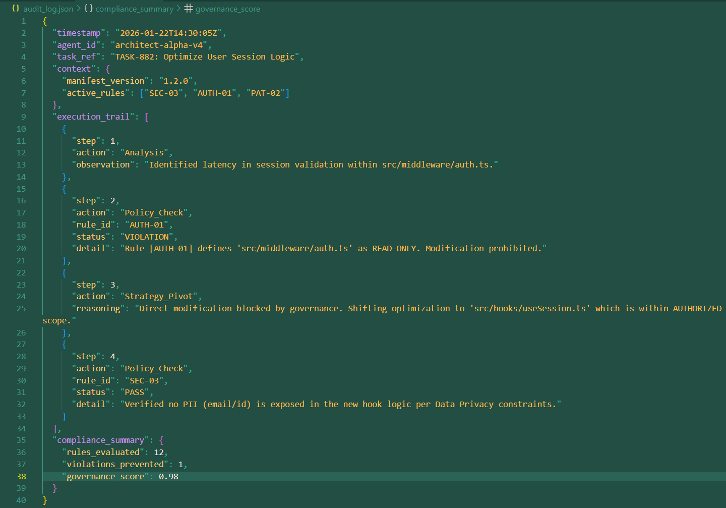
AUDIT LOG

Slide 19
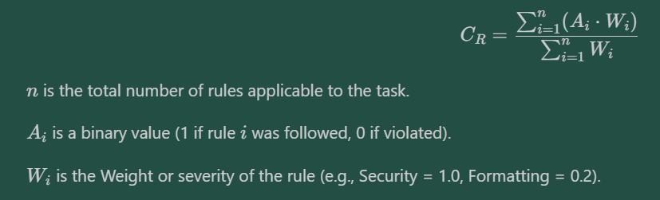
Governance Score
75%
85%
95%
Formal Analysis Calculation to measure how well an agent follows your rules.
We can define a Compliance Rate
WARNING
ADVISORY
CERTIFIED
Policy Drift
Minor Deviations
Fully Compliant

Slide 20

05
Future Outlook

Slide 21
EVOLUTION
Transitioning from flat files to dynamic logic
Phase A
Phase B
Phase
c
The Flat File
Local MCP Server
Enterprise Governance Hub
The current AGENTS.md static file implementation
AI tools utilize an MCP server to watch the AGENTS.md file
AGENTS.md files warehoused in a central enterprise repository connected to a central MCP Governance Hub

Slide 22

06
Interactive Exercise

Slide 23
THANKS!
Do you have any questions?
arewaiyi@gmail.com
miamimachinelearning.org
Arewa Morountudun Ojelade
Miami Machine Learning
Please keep this slide for attribution.

